Slide 1
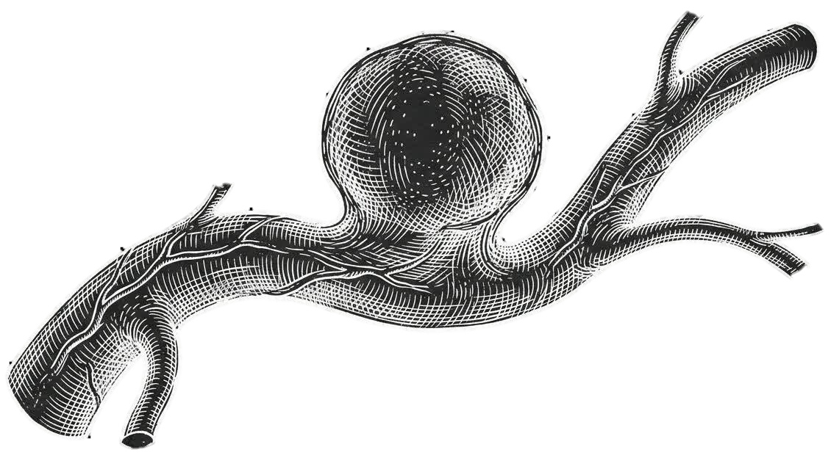
Aneurysms
A Question‑Based Introduction
From Definition to Treatment, with a Focus on Practical Clinical Concepts
Amirhossein Basekhavat _ Surgery student

Slide 2
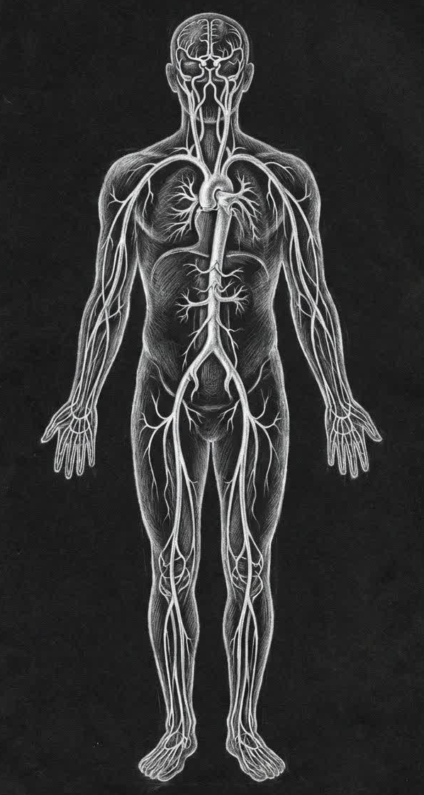
Objectives
Essential Framework
Clinical manifestations
Diagnosis
Treatment

Slide 3

Historic milestone
In 1951 in Paris, Dubost performed the first successful surgical repair of an abdominal aortic aneurysm. He resected the aneurysmal segment of the aorta and replaced it with an arterial homograft taken from another human donor.
This operation is considered the beginning of the modern era of aortic aneurysm surgery—a true turning point.
Before Dubost, an abdominal aortic aneurysm was almost always a fatal diagnosis.
Charles Dubost
1914_1991
a French surgeon, recognized as one of the fathers of abdominal aortic aneurysm (AAA) surgery.

Slide 4
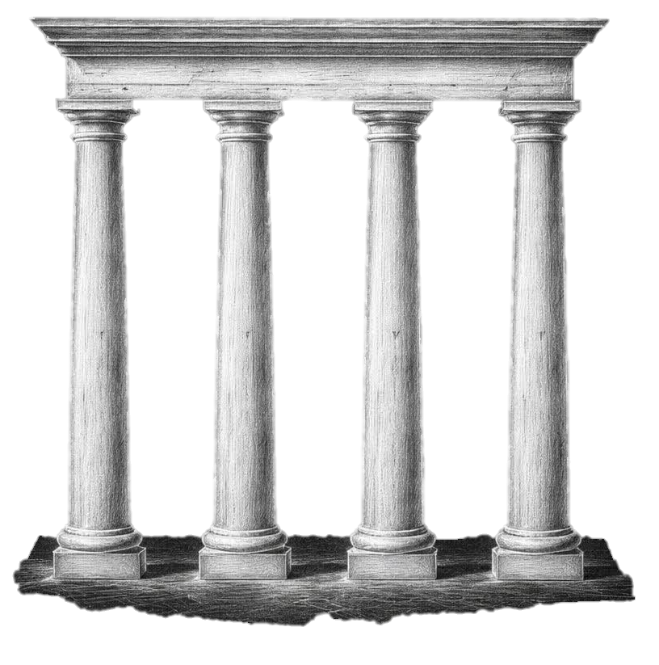
Section Ӏ
The Essential Framework

Slide 5
Why aneurysms matter ?
Aneurysms may occur in any location within the arterial tree, but are most common in the: infrarenal aorta, iliac arteries, popliteal arteries.
3% of all men older than 70 years of age have an aortic aneurysm, but
patients with high-risk factors may have an incidence of up to 10%.
Aneurysmal formation is a systemic and familial disease
20% of patients with AAA have a first-degree relative with the same disease
Its complications are DANGEROUS, and if it remains undiagnosed, it can lead to the patient’s DEATH.

Slide 6
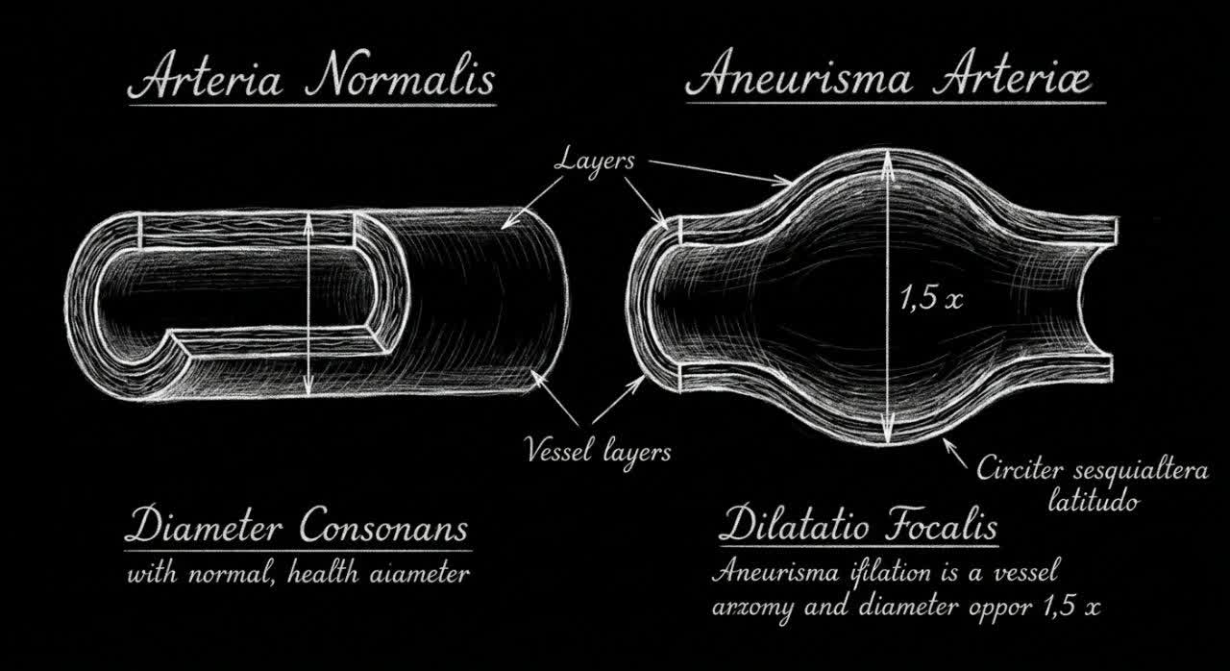
What is the Definition and True meaning of an aneurysm?
An aneurysm is a focal dilation of an artery to more than one-and-a-half times its normal diameter.

Slide 7
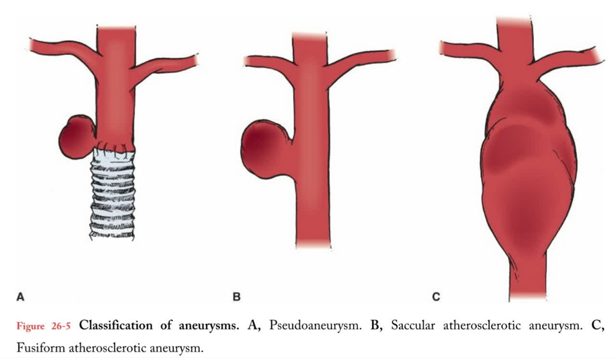
How are aneurysms classified?
By Structure:
True
false
By Shape:
Saccular
Fusiform

Slide 8
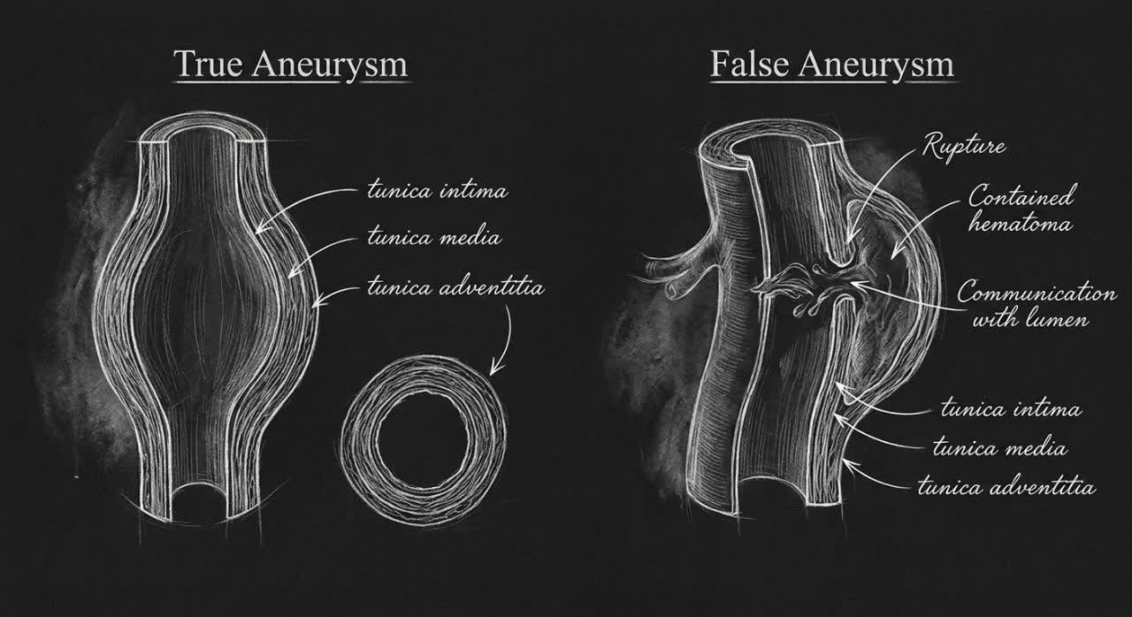

Slide 9
a Real dilation of the vessel where all original wall layers remain intact but expand.
Abdominal Aortic Aneurysm (AAA)
Atherosclerosis → chronic wall inflammation → medial elastin/collagen degradation → progressive wall weakening → dilation of the native vessel wall.
Thoracic Aortic Aneurysm (e.g., Marfan, Loeys–Dietz)
Connective tissue disorders → fibrillin/TGF‑β pathway defects → reduced medial strength → gradual true dilation of the aortic wall.
Saccular Intracranial (Berry) Aneurysm
Congenital medial weakness at arterial bifurcations + hemodynamic stress → medial degeneration → true outpouching of the vessel wall.
Classification _ True Aneurysm

Slide 10
Classification _ False Aneurysm
A contained rupture where blood escapes the vessel and forms a surrounding hematoma that still communicates with the lumen.
Femoral Artery Pseudoaneurysm after Catheterization
Arterial wall puncture during catheter insertion/removal → blood leakage
Traumatic Pseudoaneurysm
Penetrating or blunt trauma → partial arterial wall disruption → creation of a pulsatile cavity connected to the vessel.
Infected (Mycotic) Pseudoaneurysm
Infection (e.g., Staphylococcus aureus) → enzymatic destruction of the arterial wall → localized rupture
Anastomotic Pseudoaneurysm (Post‑surgical)
Leakage from a vascular anastomosis site → extravasated blood confined by surrounding tissues → formation of a cavity that communicates with the arterial lumen.

Slide 11
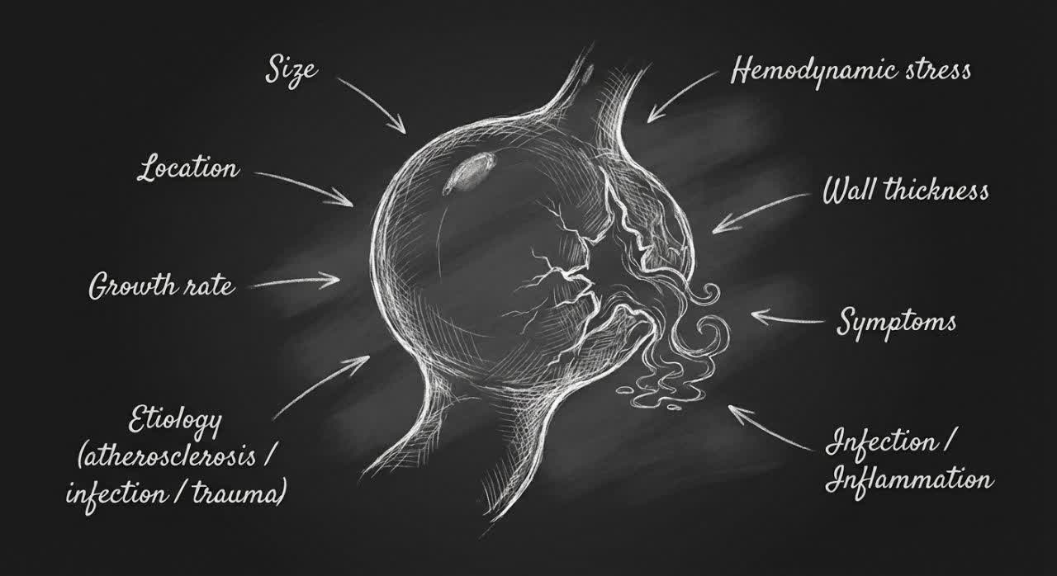
Fusiform: Chronic processes that weaken an entire vascular segment:
Atherosclerosis _ Connective tissue disorders
Saccular: Localized defect in the vessel wall: infection or trauma, Certain congenital or degenerative lesions, Vascular branch points and regions of high hemodynamic stress(Berry – most common cause of subarachnoid hemorrhage)
The risk of rupture depends on multiple factors.
• Size
• Location
• Growth rate
• Etiology
• Hemodynamic stress
• Wall thickness
• Symptoms
• Infection/Inflammation
Classification _ Saccular vs Fusiform

Slide 12
What mechanisms lead to aneurysm formation ?
1- Congenital (10-20 Y/O)
Turner syndrome (Neural crest migration)
Poststenotic dilation (Coarctation of Aorta)
Berry aneurysm (40-60 Y/O)
2- Abnormality of connective tissue
Marfan Syn (20-40)
Ehlers-Danlos Syn
Cystic medial necrosis (HTN-Aging)
3- Infection
Mycotic aneurysm
Posttraumatic (Catather-Gun-Surgery- Graft - Anastomotic aneurysm)
Infection of existing aneurysm
4- inflammatory (Female)
Takayasu Arteritis (15-40 Y/O)
Giant cell Arteritis (Temporal-Ophthalmic-thoracic A _ 50< )
Poly Arteritis Nodosa (40-60Y/O – Renal-Mesentric-Hepatic)
Sys Lupus Erythematosus (cerebral-Coronary)
5- Atherosclerosis (most common)
6- Dissection
7- Hemodynamic

Slide 13
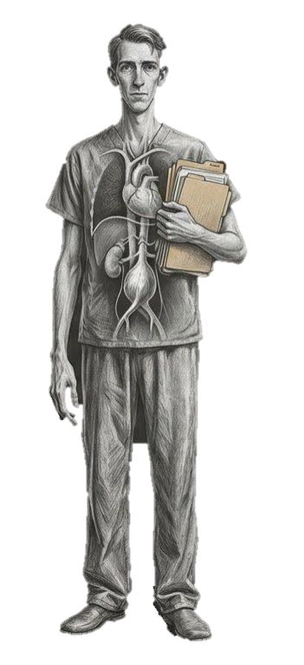
Main mechanism: intrinsic weakness of the vessel wall due to defective extracellular matrix.
Marfan syndrome: fibrillin-1 defect impairs elastic fiber support and increases TGF-β signaling
(increase MMP2,9).
Ehlers–Danlos syndrome: defective type III collagen weakens the arterial wall.
These abnormalities reduce tensile strength and elastic recoil.
Final result: the artery becomes structurally weak and prone to dilatation even without severe atherosclerosis.
Usual pattern:
More often: True & Fusiform aneurysm
Location: Ascending aorta – medium size(carotid-renal-iliac-visceral)
(Can also predispose to dissection and rupture)
Connective tissue disorder

Slide 14
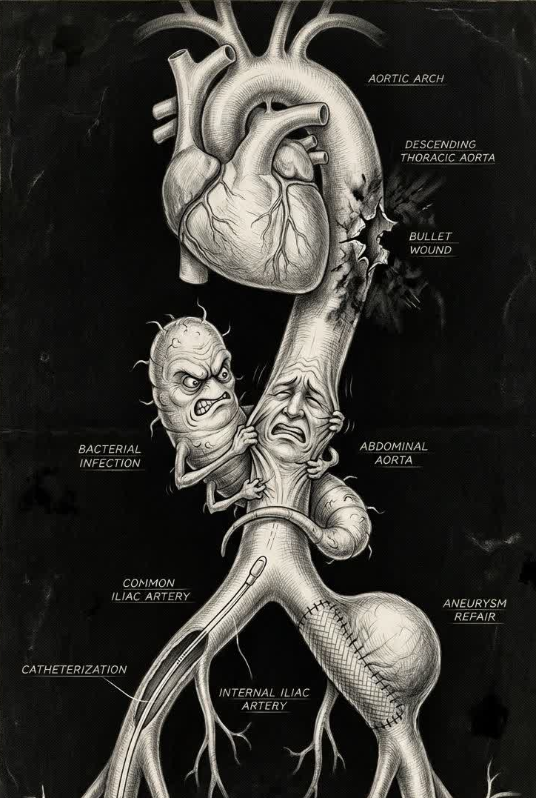
Infection
Main mechanism: infection directly destroys the arterial wall.
Bacteria(Staph aureus/Salmonella/TB) infect the vessel wall.
Bacterial toxins and intense inflammation cause enzymatic destruction of the media.
Final result: rapidly progressive, unstable aneurysm with high rupture risk.
Usual pattern:
More often: Pseudoaneurysm & Saccular
Trauma
such as stab wounds, gunshot injuries, catheter procedures, angiography, or surgery—can tear the vessel wall and lead to the formation of a pseudoaneurysm

Slide 15
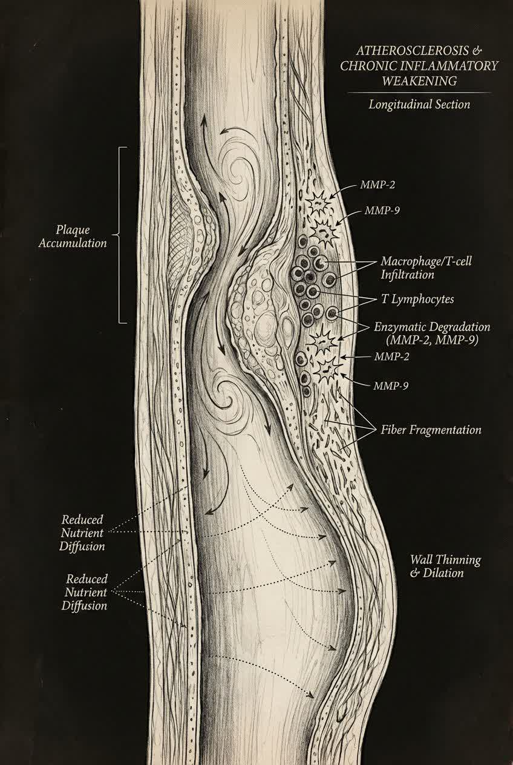
Atherosclerosis
Main mechanism:
chronic inflammation gradually weakens the arterial wall.
Atherosclerotic plaques induce chronic inflammation in the intima and media.
Macrophages and T cells infiltrate the wall and release matrix metalloproteinases (MMP-2, MMP-9).
These enzymes degrade elastin and collagen, leading to loss of structural support.
Reduced nutrient diffusion to the media further promotes wall degeneration.
Final result: wall thinning, medial weakening, and progressive dilatation.
Usual pattern: True & Fusiform aneurysm

Slide 16
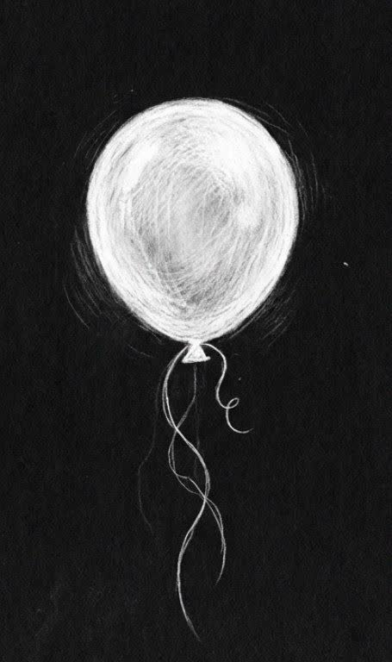
Hemodynamic
The Laplace Law & Balloon analogy
For a vessel or any cylindrical structure:
Wall stress = P × r / t
increased pressure :
HTN – Pheochromocytoma – amphetamine use
Turbulent flow(bifurcation) Plaques - Stenosis - AV fistula – AV malformation – Sever Anemia – Pregnancy –
Athletes with high CO
increased radius of an aneurysm
Aging - Atherosclerosis
decreased wall thickness
Smoking - Atherosclerosis
Pregnancy (Estrogen): Splenic / Mesentric / Renal artery Rupture
Syphilitic Aortitis

Slide 17
What Complications can aneurysms cause?
1- Related to the aneurysm wall
Rupture or Dissection
Impending Rupture: pain-Tenderness
2- Related to blood flow disturbance
Mural Thrombosis
Distal embolization
Occlusion of the aneurysm sac
Distal Ischemia
  Acute limb ischemia
  Visceral ischemia(renal-mesenteric)
  Myocardial ischemia(Coronary Anu)
3- Fistula & abnormal communication
Arterio + Venous-bronchial-biliary-enteric
4- Mass effect & local invasion
Nerves (Cranial – Recurrent laryngeal)
Airway
Esophagus (Dysphagia)
Ureter/Renal parenchyma
Spinal cord
erosion to bone & hallow organs
5- Infection & Inflammation
Sepsis / Septic Emboli / Septic shock
PeriAneurysmal inflammation

Slide 18
Essential Framework
Why aneurysms matter?
What is the Definition and True meaning of an aneurysm?
How are aneurysms classified?
What mechanisms lead to aneurysm formation?
How does Laplace’s law explain aneurysm growth and rupture?
What complications can aneurysms cause?

Slide 19

Section ӀӀ when the black swan arrives

Slide 20
Clinical presentation of Aneurysm
1- Intracranial
- Ant/Pos communicating artery aneurysm
- Middle cerebral / artery aneurysm
- Internal carotid / Vertebral artery aneurysm
- Ophthalmic artery aneurysm
2- Cervical
- Extracranial carotid artery aneurysm
- Superficial Temporal aneurysm
3- Thoracic Aorta
- Ascending aortic aneurysm
- Aortic root / Aortic arch aneurysm
- Descending thoracic aortic aneurysm
4- Abdominal Aorta
- Supra / Juxta / Infra Renal abdominal aneurysm
5- Thoracoabdominal
- Thoracoabdominal aortic aneurysm
6- Upper Extremity
- Subclavian / Axillary / Brachial / Radial / Ulnar artery aneurysm
7- Visceral
- Celiac / Splenic / Hepatic / Sup mesenteric / Renal artery aneurysm
8- Abdominal Aorta
- Common iliac / Internal iliac artery aneurysm
9- Lower Extremity
- Common femoral / Profuna femoris / Popliteal / Ant-Pos tibial/ Peroneal artery aneurysm

Slide 21
Clinical presentation of Aneurysm
Aneurysms are often discovered as asymptomatic pulsatile masses on routine physical examination or during diagnostic tests, such as ultrasound, CT scan, or MRI performed for other conditions.
Approximately 20% of aneurysms cause symptoms, including pain, thrombosis, distal
embolization, or rupture, which is the most life-threatening occurrence.
The clinical presentation reflects the location of the aneurysm:
Brain: Ptosis - Dysarthria (speech difficulty) Hemiparesis or hemiplegia - Sudden headache
Pulmonary: Hemoptysis - Hoarseness - Respiratory distress - Stridor - Persistent cough
Esophagus: Dysphagia - Sensation of food sticking
Kidney: Hydronephrosis - Elevated serum creatinine – Hematuria
AV fistula: Increased venous return - Trill sound - Localized swelling - Venous dilation

Slide 22
Abdominal Aortic Aneurysm
Intact AAA
• pain: dull abdominal pain
• radiation: mild flank radiation
• hemodynamic: normal BP
• pulsatile mass: easily palpable
• tenderness: mild mid‑abdomen
• distension: none
• peritoneal signs: absent
• flank findings: normal
• clinical stability: stable
• GI symptoms: early satiety / fullness
• abdomen texture: soft / mild tenderness
• ecchymosis: none
• syncope: absent
• overall picture: stable + pulsatile mass
Intact AAA
- Usually Asymptomatic
- Physical Exam
Pulsatile abdominal mass (midline)
Ruptured AAA
Retro Peritoneal
Intra Peritoneal (More DANGREOUS & rapidly FATAL)
1- Sever Abdominal(Back or Flank) pain
2- Hypotension/shock
3- Pulsatile abdominal Mass

Slide 23
Intraperitoneal Rupture
• pain: sudden diffuse abdominal pain
• radiation: non‑specific / diffuse
• hemodynamic: profound shock
• pulsatile mass: difficult to palpate
• tenderness: diffuse + peritonitis
• distension: marked distension
• peritoneal signs: rebound + rigidity
• flank findings: usually absent
• clinical stability: rapidly unstable
• GI symptoms: nausea + vomiting
• abdomen texture: rigid / board‑like
• ecchymosis: possible Cullen (late)
• syncope: common collapse
• overall picture: shock + peritonitis + distension
Retroperitoneal Rupture
• pain: sudden flank/back pain
• radiation: flank/groin/testicular radiation
• hemodynamic: mild–moderate hypotension
• pulsatile mass: usually palpable
• tenderness: mid‑abdomen + flank
• distension: none
• peritoneal signs: absent
• flank findings: flank tenderness ± Gray Turner
• clinical stability: transiently stable (tamponade)
• GI symptoms: mild nausea
• abdomen texture: soft / flank tenderness
• ecchymosis: possible Gray Turner
• syncope: possible transient syncope
• overall picture: flank pain + partial tamponade

Slide 24
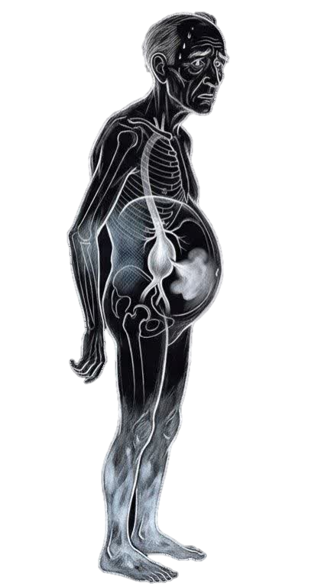
A 65‑year‑old very tall, Man with long‑standing hypertension, severe anemia, advanced atherosclerosis, and recently diagnosed pulmonary TB presents to the ED with sudden severe abdominal and back pain.
He describes the pain as deep, tearing, and radiating to the left flank and groin. He appears pale, anxious, and diaphoretic.
On arrival he is hypotensive and tachycardia, with cool extremities and delayed capillary refill. His abdomen is distended, tense, and diffusely tender, with guarding and rebound. A large pulsatile abdominal mass is clearly palpable. There is marked flank tenderness and faint bluish discoloration over the left flank, suspicious for an evolving Gray Turner sign.
He reports early satiety, recent episodes of nausea, and one episode of vomiting just before arrival. He had progressive abdominal fullness over the past week.
No history of trauma. Peripheral exam reveals diminished distal pulsesand mottled toes suggestive of distal embolization. Mental status fluctuates between restlessness and near‑syncope.
The overall picture strongly suggests ruptured abdominal aortic aneurysm, likely transitioning toward profound shock

Slide 25
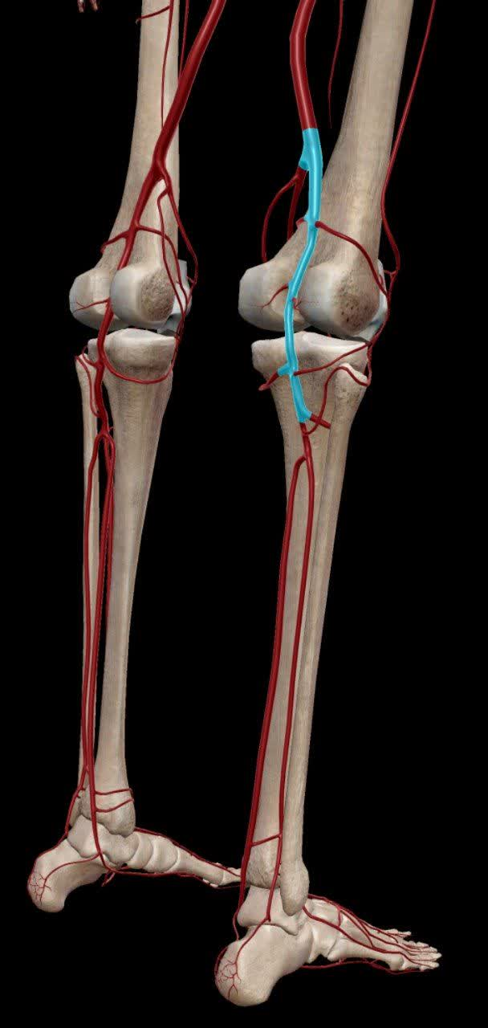
Popliteal Aneurysm
About 90% of popliteal artery aneurysms undergo thrombosis rather than rupture.
intramural thrombus formation → distal embolization → acute limb ischemia
Symptom
Dull popliteal pain
Fullness sensation in popliteal fossa
Claudication (due to turbulent flow)
Foot Paresthesia (Tibial nerve)
episodic Foot cooldness
Sign
Pulsatile popliteal mass(hallmark)
Popliteal swelling
popliteal artery Bruit
Signs of Chronic MicroEmbolization:
Blue toe syndrome
Livedo reticularis
Ischemic patches on toe

Slide 26
ӀӀ. Clinical manifestation
What symptoms does an aneurysm present with?
In which anatomical regions or areas do the clinical manifestations of an aneurysm appear?
What are the clinical manifestations of an abdominal aortic aneurysm (AAA)?
What are the clinical manifestations of a popliteal artery aneurysm?

Slide 27
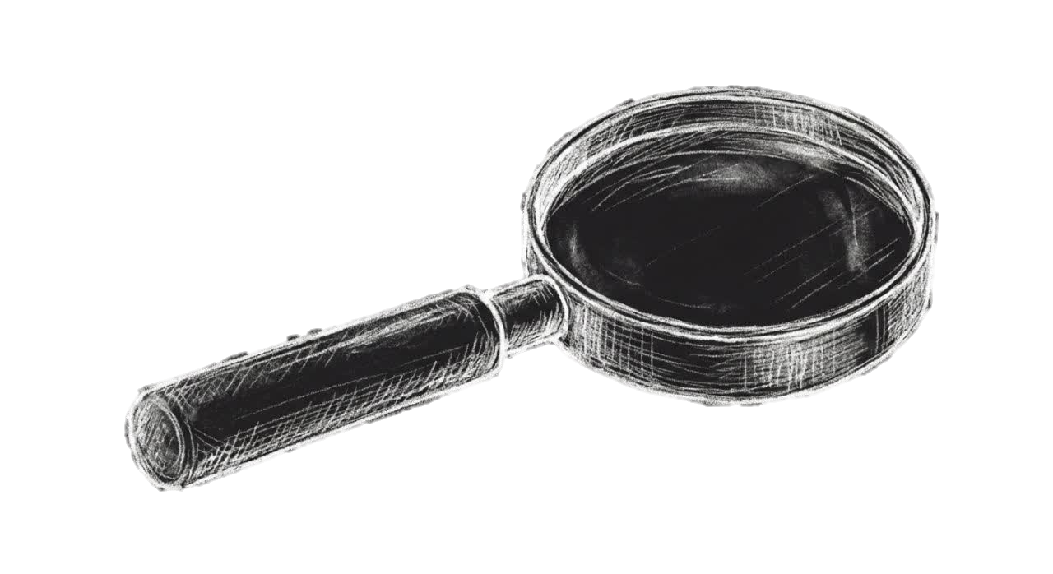
Section ӀӀӀ
Diagnosis of The Disease

Slide 28
How is an aneurysm diagnosed?
As noted previously, the diagnosis of aortic and peripheral artery aneurysms is often made during a routine
physical examination. If an aneurysm is suspected, the patient should undergo a diagnostic evaluation.
Clinical suspicion & physical exam
• Pulsatile mass detected on exam
• Vascular bruit over the artery
• Compression symptoms (pain, fullness)
• Ischemic symptoms (blue toes, claudication)
• Abdominal/back/limb pain in high‑risk patients
Imaging confirmation
• Size assessment
• Exact location
• Extent of aneurysm
• Branch involvement
• Need for intervention

Slide 29
What is the best choice for diagnostic evaluation?
Ultrasonography is the first‑line tool for detecting aneurysms.
It provides a quick, non‑invasive, inexpensive assessment of aneurysm size and general location, making it ideal for screening and follow‑up.
However, it lacks the detailed anatomical precision needed for operative planning.
Main role | Advantages | Clinical use | Limitation
First line screening | Non invasive | Screening program | Limited anatomical detail
Diameter measurement | Low cost – Widely available | Initial evaluation of suspected AAA | Poor image quality with obesity or bowel gas
General location assesment | No radiation – No contrast High accuracy for Size (95%) | Surveillance of small, known aneurysms | Not sufficient for surgical/EVAR planning

Slide 30
When do we use other diagnostic tools?
CT provides high‑resolution anatomical detail, allowing precise definition of aneurysm extent and location.
It is the standard next step after a significant aneurysm is found on ultrasound and is crucial in symptomatic patients or when rupture is suspected.
CT is often used to determine whether the patient needs intervention.
Main role | Advantages | Clinical use | Limitation
Detailed anatomical evaluation | Superior anatomical resolution | After AAAs detected on US | Not suitable for Pregnant pations- Radiation
Determining infrarenal vs suprarenal involvement | Better visualization of surrounding structures | Pre‑intervention planning | Availability & Time
Assessing extent of aneurysm | Essential for treatment decision‑making | Symptomatic or unstable patients
 |  | Suspected rupture or rapid expansion

Slide 31
When do we use other diagnostic tools?
CT-Angiography is the gold standard for evaluating vascular anatomy in aneurysm patients.
It allows precise visualization of the arterial lumen, branch vessels, aneurysm neck, and the full vascular tree, making it foundational for surgical and endovascular planning.
CTA has largely replaced invasive catheter‑based angiography.
Main role | Key evaluation | Important Indication | Clinical note
Detailed lumen and arterial mapping | Aneurysm neck morphology | Planning for AAA repair | CTA has replaced most invasive angiography
Pre‑operative and EVAR planning | Branch artery involvement | EVAR planning | Provides complete non‑invasive vascular mapping
Assessment of branch involvement and neck anatomy | Extent of the aneurysm | Peripheral artery aneurysm evaluation

Slide 32
In which individuals is screening indicated?
1) Men aged 65–75 years who have ever smoked
One-time abdominal ultrasonography is recommended
Grade B
Ever smoked = smoked at least 100 cigarettes in a lifetime
2) Men aged 65–75 years who have never smoked
Selective screening rather than routine screening
Grade C
- Decision should be based on:
- family history of AAA
- other risk factors
- overall health status
- patient preference
3) Women who have never smoked and have no family history of AAA
- Screening is not recommended
- Grade D (harm > benefits)
4) Women aged 65–75 years who have ever smoked or have a family history of AAA
- Evidence is insufficient to assess the balance of benefits and harms
Grade I
Major Risk Factors for AAA
- Older age
- Male sex
- Smoking
- Family history of AAA
- Atherosclerotic disease
- Hypertension
Reference
USPSTF Recommendation Statement
Abdominal Aortic Aneurysm: Screening

Slide 33
ӀӀӀ. Diagnosis of the disease
How is an aneurysm diagnosed?
What is the best choice for diagnostic evaluation?
When do we use other diagnostic tools?
In which individuals is screening indicated?

Slide 34
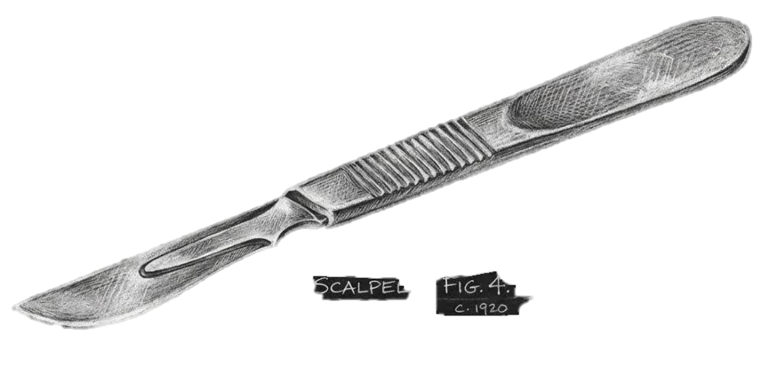
Section ӀV
Treatment of The Disease

Slide 35
When Do We Decide to Proceed with Surgical Treatment (AAA)?
1- Based on Aneurysm Size
AAA > 5.5 cm in men
AAA > 5.0 cm in women → surgery is typically recommended
2- Based on Growth Rate
>0.5 cm increase in 6 months
>1.0 cm increase in 1 year
Such rapid expansion suggests instability and a high risk of rupture.
3- Based on Rupture or Leak
If there is ruptured or leaking AAA, this is an emergency:
Immediate surgical (open or endovascular) repair is life-saving.
Mortality is very high without prompt intervention.
4- Based on Symptoms
Surgical repair is indicated regardless of size if the patient develops symptoms such as:
Abdominal or back pain (suggesting impending rupture)
Tender pulsatile mass
Embolic phenomena (leg ischemia due to thrombus)
Any signs of leak or contained rupture on imaging
5- Based on Patient and Anatomic Factors
Suitable anatomy for EVAR? → Do minimally invasive EVAR.
Unfavorable anatomy (short neck, tortuous iliacs, involvement of renals)? → Consider open repair.
High surgical risk (severe comorbidities)? → Prefer EVAR if feasible, or medical surveillance only if not.

Slide 36
Management of patient with ruptured AAA?
Patients presenting with a ruptured aneurysm face imminent mortality if not treated immediately
Clinical Presentation & Immediate Action
Patients presenting with the classic triad must be transferred to the operating room (OR) without delay:
Back pain
Hypotension
Pulsatile abdominal mass
During transport to the OR, these patients should undergo resuscitation with minimal fluid and blood volumes (limited volume resuscitation).
Current Management Strategy: Permissive Hypotension
The current therapeutic approach utilizes a technique known as Permissive Hypotension:
* Target: Systolic blood pressure is maintained between 70–80 mmHg.
* Monitoring: Continuous assessment of mental status and end-organ perfusion is mandatory.
* Objective: To minimize ongoing hemorrhage from the rupture site by avoiding high-pressure surges.

Slide 37
What treatment options are available for aneurysms?
1. Medical Management & Surveillance
This approach is not a definitive treatment; it focuses on controlling aneurysm growth and preventing rupture.
It is used in cases such as:
• Small AAA
• High‑risk patients for whom surgery is dangerous
• Patients who decline surgery
Main components of medical management:
• Blood pressure control (beta‑blockers, ACE inhibitors)
• Smoking cessation
• Lipid control
• Management of cardiovascular disease
• Exercise and lifestyle modification
• Regular imaging follow‑up with ultrasound
Recommended surveillance intervals:
• AAA 3–4 cm → Ultrasound every 2–3 years
• AAA 4–4.9 cm → Ultrasound every 12 months
• AAA 5–5.4 cm → Ultrasound or CT every 6 months

Slide 38
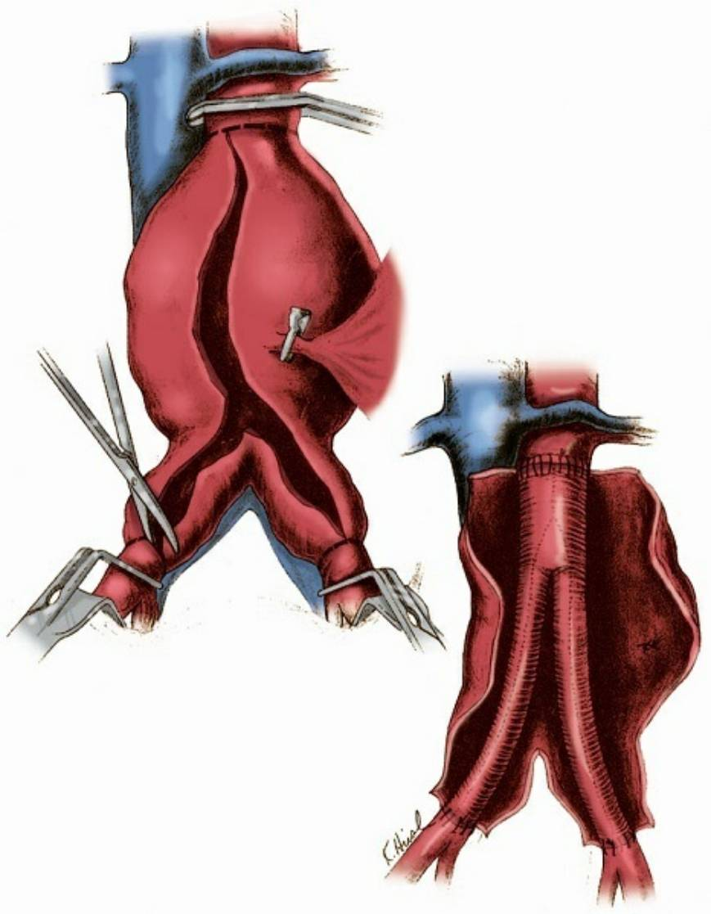
What treatment options are available for aneurysms?
2- Open Surgical Repair
This is the classic and definitive treatment for AAA.
In this procedure, the affected portion of the aorta is clamped, the aneurysmal segment is excised, and a synthetic graft (Dacron) is placed.
Key steps:
• Laparotomy
• Aortic control
• Resection of the aneurysm and graft placement
• Closure of the abdomen
Advantages:
• Definitive treatment
• No need for lifelong imaging follow‑up
• Long durability of the graft

Slide 39
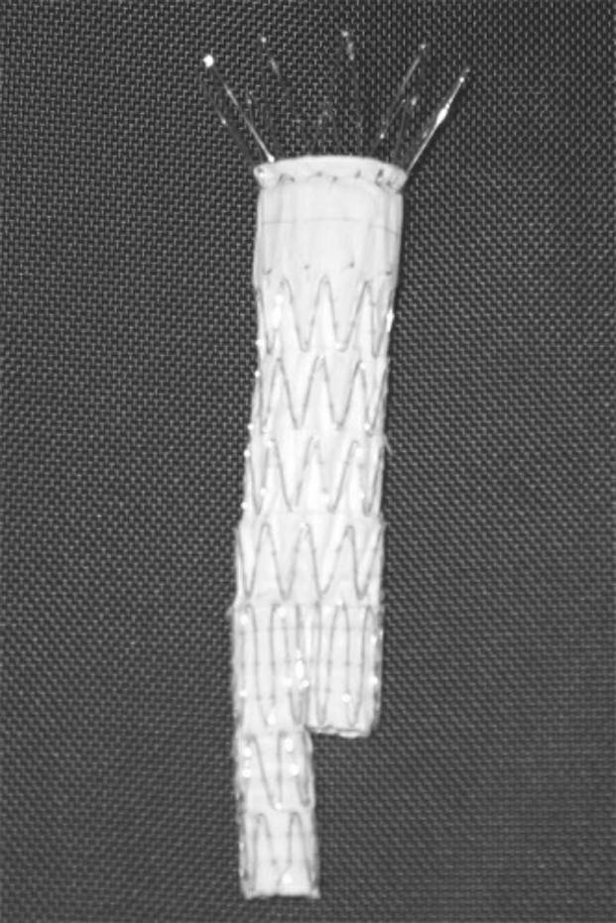
What treatment options are available for aneurysms?
2- Open Surgical Repair
Limitations / disadvantages:
• Higher short‑term mortality(%40-%70 / %3) compared to EVAR(%20-%30 / %1)
• Longer recovery period
• Not ideal for high‑risk patients
• Risks of bleeding, MI, renal failure, and respiratory complications
Strong indications:
• Unfavorable anatomy for EVAR
• Rupture cases in which EVAR is not feasible
• Younger, low‑risk patients

Slide 40
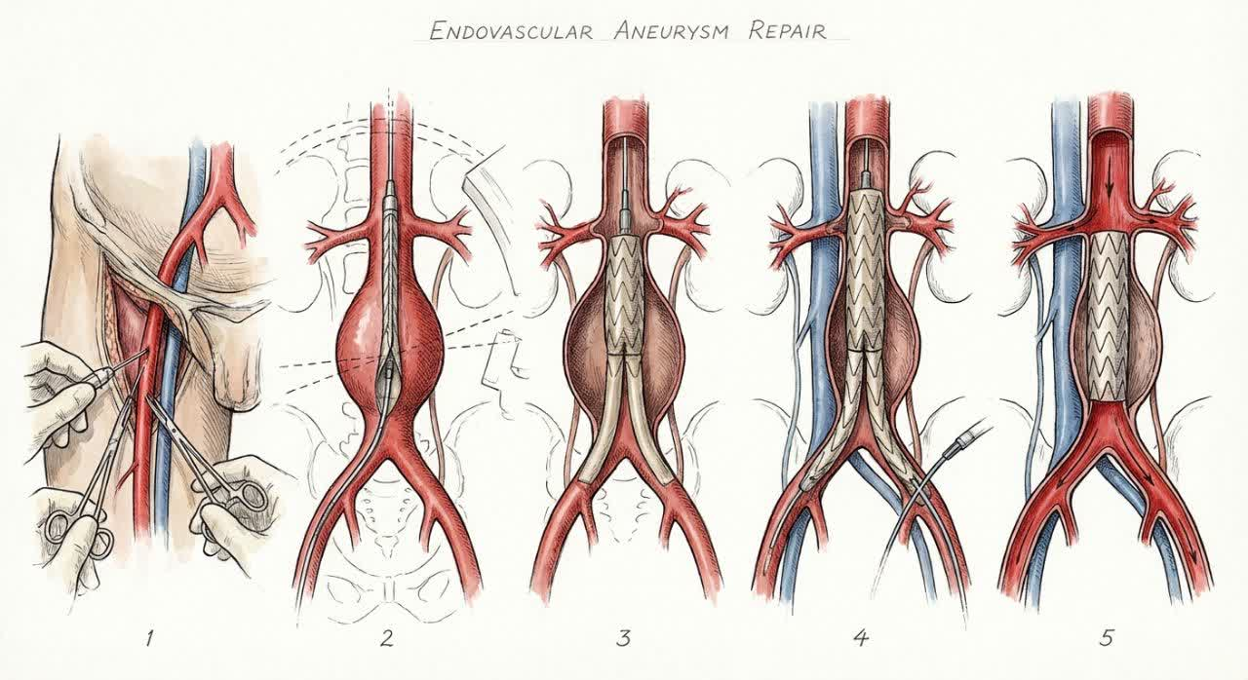
What treatment options are available for aneurysms?
3- Endovascular Aneurysm Repair (EVAR)
This is the least invasive treatment for AAA.
In EVAR, a stent‑graft is delivered through the femoral artery to exclude the weakened aneurysm wall from blood flow.
Steps:
• Femoral artery access
• Navigation of the graft under fluoroscopy
• Deployment of the graft below the renal arteries
• Expansion of the limbs into the iliac arteries
• Exclusion of the aneurysm sac from systemic pressure
Advantages:
• Lower mortality compared to open surgery
• Shorter hospital stay
• Suitable for high‑risk patients
• Minimally invasive with quicker recovery

Slide 41
What treatment options are available for aneurysms?
3- Endovascular Aneurysm Repair (EVAR)
Disadvantages:
• Requires lifelong annual follow‑up (CT or ultrasound)
• Risk of endoleak
• Potential need for secondary interventions
• Risk of kidney injury due to contrast
• Requires favorable anatomy (aortic neck, renal artery position)
Strong indications:
• High‑risk patients
• Suitable anatomy for EVAR
• High‑volume & experienced centers

Slide 42
How to Choose the Best Treatment?
EVAR is preferred if:
• Anatomy is suitable
• The patient is high‑risk
• The center has strong experience
Open repair is preferred if:
• Anatomy is unsuitable for EVAR
• The patient is young and low‑risk
• Rupture cases where EVAR is technically not possible
Medical management is used if:
• AAA is small
• The patient is high‑risk for surgery
• The patient declines surgical intervention

Slide 43
ӀV. Treatment of the disease
Management of patient with ruptured AAA?
What treatment options are available for aneurysms?
what are the characteristics of each method?
When do we decide to proceed with surgical treatment?
How to Choose the Best Treatment?

Slide 44

Thank you for your attention to this matter
“The good physician treats the disease; the great physician treats the patient who has the disease.”
— Sir William Osler

